Slide 1
ITC COURSE PROJECT
ITC: INFORMATION THEORY AND CODING
Department of Electronics & Communication Engineering
The LNMIIT, Jaipur
Submitted by-
Ashish Kumar Singh (Y13UC054)
Deepak Gupta (Y13UC075)

Slide 2
Arithmetic Coding and Decoding
APPLICATION IN TEXT (DATA) COMPRESSION

Slide 3
What is Arithmetic Coding ?
Arithmetic coding is based on the concept of interval subdividing.
  In arithmetic coding a source ensemble is represented by an interval between 0 and 1 on the real number line.
  Each symbol of the ensemble narrows this interval.
  As the interval becomes smaller, the number of bits needed to specify it grows.
  Arithmetic coding assumes an explicit probabilistic model of the source.
  It uses the probabilities of the source messages to successively narrow the interval used to represent the ensemble.
    A high probability message narrows the interval less than a low probability message, so that high probability messages contribute fewer bits to the coded ensemble

Slide 4
Some Highlights
The idea of arithmetic coding comes from Shannon-Fano-Elias coding.
The algorithm was implemented in a practical manner by IBM around 1980. IBM obtained a patend for arithmetic coding and defended it vigorously for approximately 20 years.
The value of the algorithm as intellectual property was estimated at tens of billions of dollars.
Now there are many freely available implementations of arithmetic coding, including the MATLAB implementation.
Used in High definition Camera and Video streaming, Cellular technology,

Slide 5
Data Compression = Data Modeling + Source Coding

Slide 6
Approach
Objective-
A MATLAB program designed to encode and decode a given text file (containing some text) without knowing their probabilities. The program lists out the symbols used and calculates their individual probabilities to code and thus, decode the tag. The final value as well the required size is compared and analysed.

Slide 7
Content
Text file Which will hold the content (Input.txt)
Encoder matlab Code (Encoder.m)
Decoder matlab Code (Decoder.m)
Final Output stored in another text file (Output.txt)
Encoded (Encrypted) File (Output.zzz)

Slide 8
Test Input I:
“Ashish”
“Deepak”
“AABBBCC”
“arithmetic coding”
“arithmetic.coding”
“111111122233”
“AABDERJFLSDJCNSSLCLLLSSLSLSLSLSLSLS”

Slide 9
Test Input II:
“Arithmetic coding is a form of entropy encoding used in lossless data compression. Normally, a string of characters such as the words "hello there" is represented using a fixed number of bits per character, as in the ASCII code. When a string is converted to arithmetic encoding, frequently used characters will be stored with fewer bits and not-so-frequently occurring characters will be stored with more bits, resulting in fewer bits used in total.”
“It is a truth universally acknowledged, that a single man in possession of a good fortune, must be in want of a wife. However little known the feelings or views of such a man may be on his first entering a neighbor hood, this truth is so well fixed in the minds of the surrounding families, that he is considered the rightful property of some one or other of their daughters.”

Slide 10

Software Package Used:
MATLAB 2015B
MATLAB (matrix laboratory) is a multi-paradigm numerical computing environment and
fourth-generation programming language.
Communications System Toolbox
It provides algorithms and apps for the analysis, design, end-to-end simulation,
and verification of communications systems in MATLAB
arithenco
Encode a sequence of symbols using arithmetic coding
arithdeco
Decodes using arithmetic coding

Slide 11
Encoding Process
The program lists out the symbols used and calculates their individual probabilities to code and thus, decode the tag. Example
Example-BILL GATES
The algorithm to accomplish this for a message of any length is is shown below:
Set low to 0.0
Set high to 1.0
While there are still input symbols do
get an input symbol
code_range = high - low.
high = low + range*high_range(symbol)
low = low + range*low_range(symbol)
End of While
output low

Slide 12
New Character Low value High Value
------------- --------- ----------
0.0 1.0
B 0.2 0.3
I 0.25 0.26
L 0.256 0.258
L 0.2572 0.2576
SPACE 0.25720 0.25724
G 0.257216 0.257220
A 0.2572164 0.2572168
T 0.25721676 0.2572168
E 0.257216772 0.257216776
S 0.2572167752 0.2572167756
So the final low value, 0.2572167752 will uniquely encode the message "BILL GATES" using our present encoding scheme.

Slide 13
Decoding Process:
The algorithm for decoding the incoming number looks like this:
get encoded number
Do
find symbol whose range straddles the encoded number
output the symbol
range = symbol low value - symbol high value
subtract symbol low value from encoded number
divide encoded number by range
until no more symbols

Slide 14
The decoding algorithm for the "BILL GATES" message will proceed something like this:
Encoded Number Output Symbol Low High Range
-------------- ------------- --- ---- -----
0.2572167752 B 0.2 0.3 0.1
0.572167752 I 0.5 0.6 0.1
0.72167752 L 0.6 0.8 0.2
0.6083876 L 0.6 0.8 0.2
0.041938 SPACE 0.0 0.1 0.1
0.41938 G 0.4 0.5 0.1
0.1938 A 0.2 0.3 0.1
0.938 T 0.9 1.0 0.1
0.38 E 0.3 0.4 0.1
0.8 S 0.8 0.9 0.1
0.0

Slide 15
Results I & II:
“Ashish”
“Deepak”
“AABBBCC”
“arithmetic coding”
“………………….”
“111111122312”
“CAABBFBFABD”

Slide 16
Results III:
“ cn is a togtwetonyatwtn rbnwragrenal stdn con lisieepchdrs tw iqeifaisrleora eacarm retceirwhrooiuerscuiula rubwe sdmqasseaenoadlafhb emunoggrec suir .tcs,shgreoipeptdidir infsedfW n ssnhuedherasi hrfsuslo ibcae lo rd b coi mosndaitdt m ebfssbc b rrodctsrey lb spoogncenao ces tow Wn.lsltnmxit s weoedbgcnscnolncvuumnucrenr gmpWgdNecr rahmro hheie Wi fwtgnt n iionein,tr lriesoa grsir tn,o .pinnhn rWihr Sca htts.c bsftnida di,rtu ny nno u v r I”
“e saifd esyrewtlm,uaspno, lninprufnitudssf h seatanf.is hotodieo onfcs .na,leatilo d oenbuo i. rnnorfdt ixywo bo rso sxs s cd hrnpl ltgrtiro i leati. usxth rett eos.nenre n uvud wwooeihee,i tniagentouieeetbahhierero tsw aengnardeus n iif uoleons nfoshw ihaciagswite ho teigroeviuuu sso tegncn igah ikotswaeedoeonr,errh trsmc ofdeoiteuipli iffh uur f y osr sn”

Slide 17
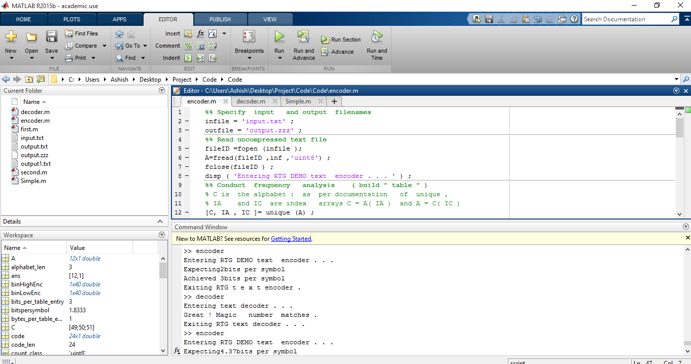

Slide 18
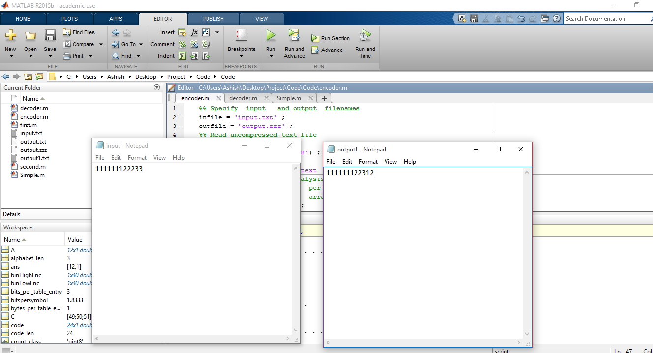

Slide 19
Observation
Data compression ratio, also known as compression power, used to quantify the reduction in data-representation size produced by a data compression algorithm
Compression ratio =Uncompressed Data/Compressed Data
Compression_ratio=(8*length (A) ) / length (code)
Values range from 1.8 to 4.7
Efficiency however, is a problem with a efficiency of
About 20% for large data set,
40% for medium data set and about
90% for small samples.

Slide 20
Final Conclusion & Limitations
The given program was made and analysed over a host of samples. The compression ratios were found desirable and proper. However the efficiency was not as per expectation and needs to be improved. (Error detecting Capability.)

Slide 21
Thank You
References-
http://alamos.math.arizona.edu/math577/ITC
http://www.cc.gatech.edu/~jarek/courses/7491/Arithmetic.pdf
http://www.cs.umb.edu/~rvetro/vetroBioComp/compression/WittenACM87ArithmCoding.pdf
http://www.ittc.ku.edu/~jsv/Papers/HoV94.arithmetic_codingOfficial.pdf

